Slide 1
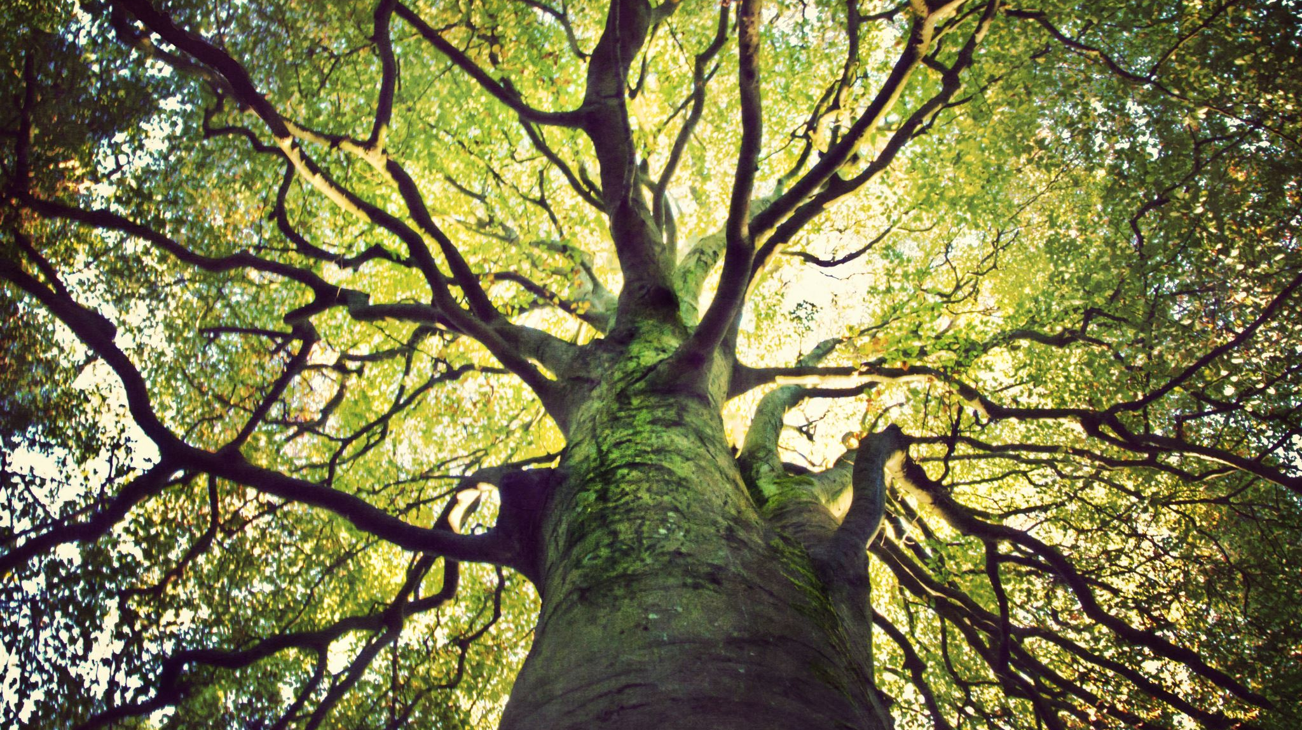
Native Oaks of Minnesota
PPM 09/30/2024
Tree ID

Slide 2
Family: Fagaceae
Oak, Chestnut, Beech
(Quercus, Castanea, Fagus)
Not Horse Chestnut! (Aesculus)
Characterized by cupule nuts where some of the nut is visible.
There is generally only one seed per nut in this family of trees.
High density per cubic foot.
Slower growing trees
Catkins instead of flowers

Slide 3
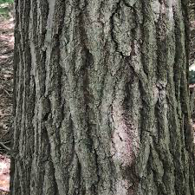
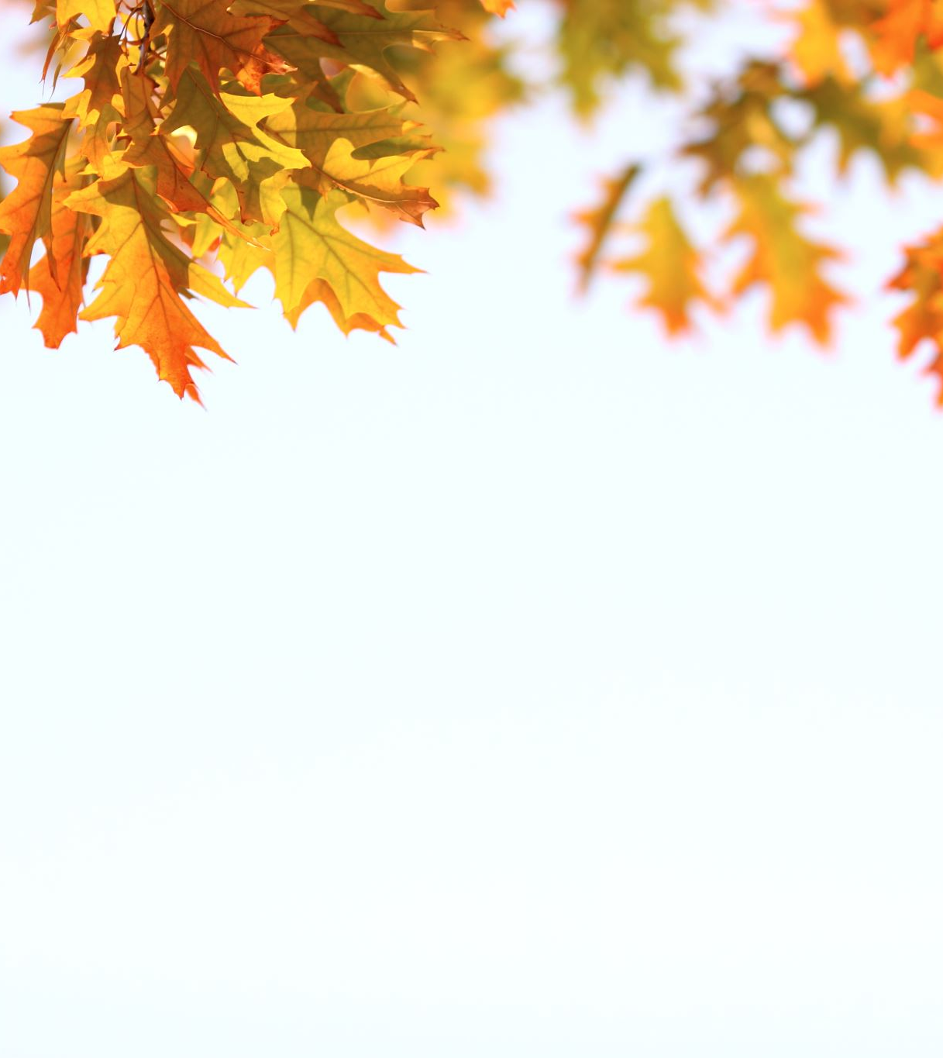
Red Oaks
Erythrobalanus “Red Oak Family” Trees that appear similar microscopically but differ phenotypically.
-Acorns mature in two years instead of one.
-Leaf lobes have bristled ends. Ellipsoidallis, Rubra, Palustris
-Edges of acorns are smoother than White Oaks

Slide 4
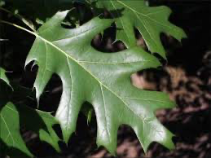
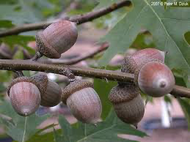
Red Oak Quercus rubra

Slide 5
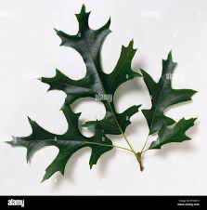
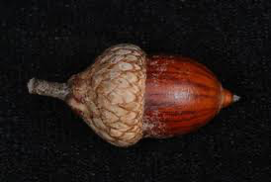
Northern Pin Oak Quercus ellipsoidalis

Slide 6
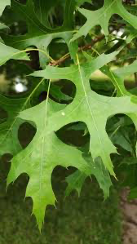
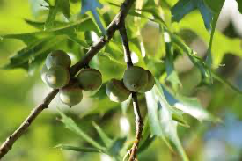
Eastern Pin Oak Quercus palustris

Slide 7
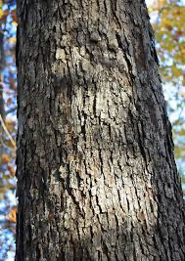
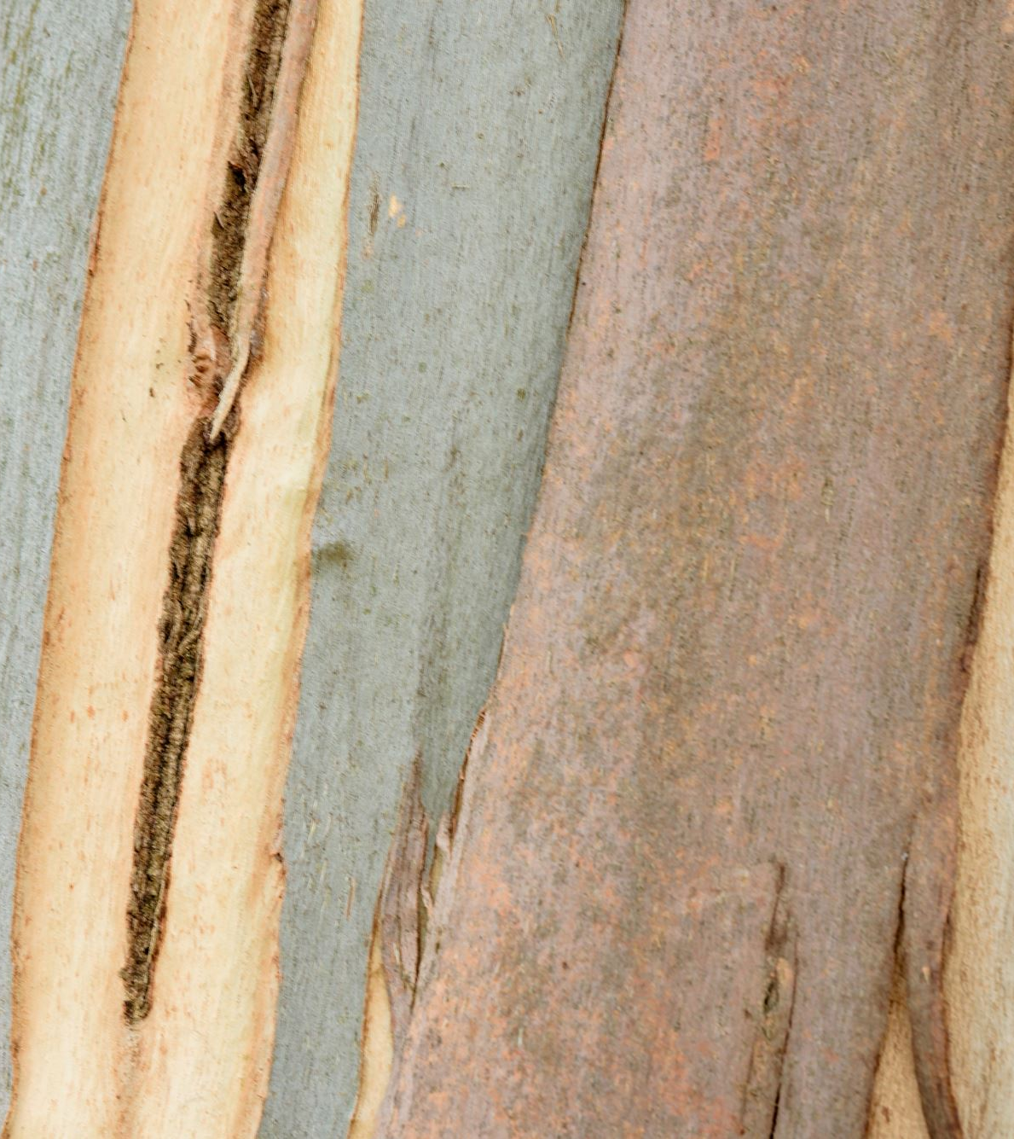
White Oak Family
Leucobalanus “White Oak”- trees in this group appear similar microscopically but differ phenotypically.
Acorns mature in one year.
Leaf lobes are rounded and do not have bristled ends.
Macrocarpa, Bicolor, Alba
Acorns are rougher and hairier than Red Oaks

Slide 8
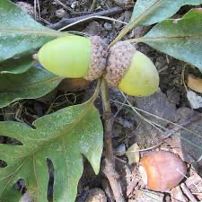
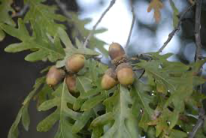
White Oak Quercus alba

Slide 9
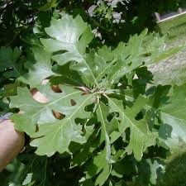
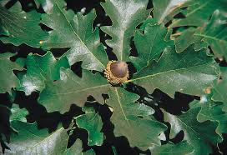
Bur Oak Quercus macrocarpa

Slide 10
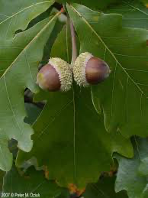
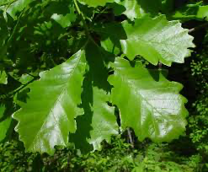
Swamp White Oak Quercus bicolor

